Slide 1
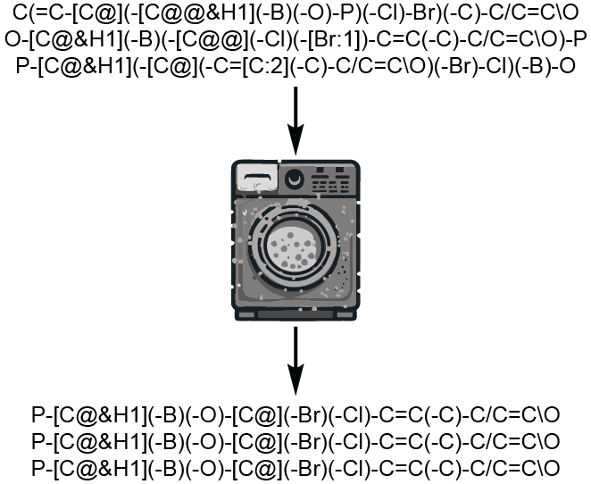
RDCanon: A Python Package for Canonicalizing the Order of Tokens in SMARTS Queries
Babak Mahjour
Coley Research Group
RDKit UGM, April 10th, 2025

Slide 2
SMILES vs SMARTS
SMILES
“Simplified Molecular Input Line Entry System”
Originally specified by David Weininger in the 1980s
A line notation to describe the (3D) structure of a molecule or chemical
Used to create databases of chemically valid molecular structures
SMARTS
“SMILES arbitrary target specification”
A molecular pattern language documented by Daylight Information Systems in the 1980s
A line notation to describe substructural patterns within molecules
Used to describe chemical motifs, filter molecular databases, to create indexes or fingerprints, describe chemical reactivities, specify force fields, etc
STRUCTURE
PATTERN

Slide 3
Canonicalization for SMARTS: Why?
Canonical SMILES
Consolidation of molecular databases
Optimization of SMILES string based on atomic invariants
Facilitate isomorphism tests
Algorithms are well studied and work robustly, despite some edge cases (symmetries, chiralities, aromaticity models, tautomers, etc.)
Canonical SMARTS
Consolidation of pattern and template databases (PAINS, retrosynthetic models, etc.)
Optimization of subgraph isomorphism algorithms based on frequency embeddings of query primitives
Improve performance of machine learning models
O(n*m) where n = # of molecular structures in database and m = # of patterns/templates

Slide 4

Canonicalization of SMILES
65
63
140
166 (141 (66) 65) (140 128 (63) 62) 76
128
166
141
66
C (C (O) =O) (C C (O) =O) N
62
76
How does SMILES canonicalization work?
Assign initial atomic invariants (descriptor based on atomic identity, hybridization, etc.)
Convolution/Message Passing/Morgan’s Algorithm (1965)
Repeat step 2 until each node label is unique
Depth first traversal to generate canonical SMILES, using parentheses for branch points

Slide 5
It won’t work for SMARTS
Fundamental differences between the languages of SMARTS and SMILES prevent a naïve application of message passing to generate optimal token ordering:
No presumption of a chemically valid molecular graph: “[c][c][c]” is totally valid as a SMARTS but not a SMILES
Expansive data structure: SMARTS tokens are comprised of query primitives that are joined into SQL clauses and can include recursive expressions
No formulation of graph convolution maintains the rank ordering of embedded frequencies
Not just canonicalization – token ordering is critical to algorithmic performance. While distinct, canonicalization and optimization go hand-in-hand

Slide 6
RDCanon
How to canonicalize SMARTS:
Parsing
Sorting
Decoding
Regeneration of stereochemistry

Slide 7
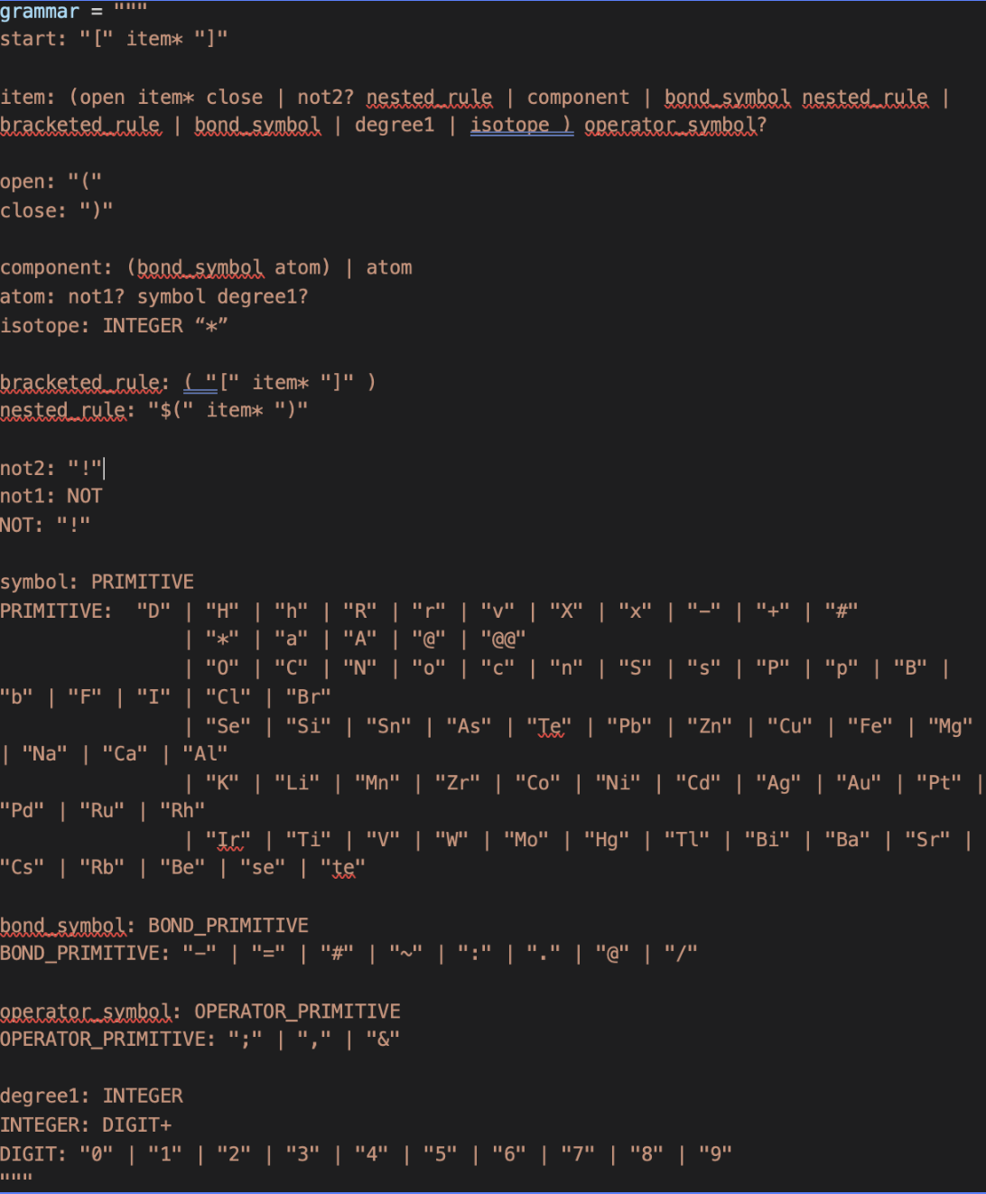
RDCanon
How to canonicalize SMARTS:
Parsing
Sorting
Decoding
Regeneration of stereochemistry
A grammar was developed to encode SMARTS strings into a tractable data format

Slide 8
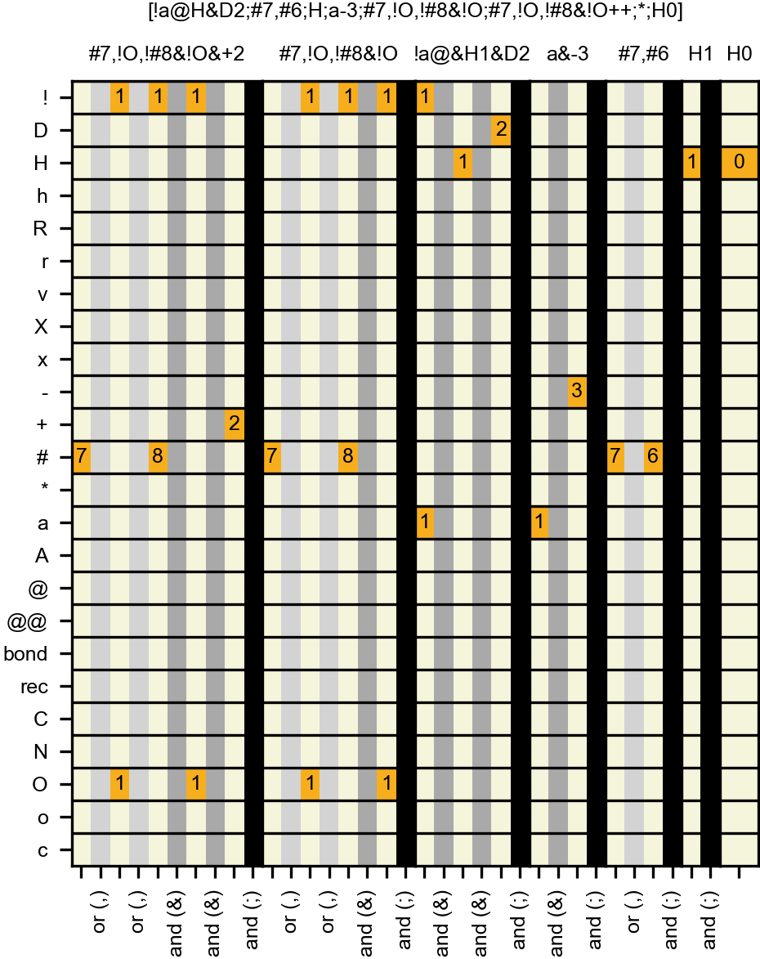
RDCanon
How to canonicalize SMARTS:
Parsing
Sorting
Decoding
Regeneration of stereochemistry
A grammar was developed to encode SMARTS strings into a tractable data format
Hash table enables initial consolation of subqueries and removal of redundancies (e.g., [O+++] becomes [O&+3], [C;H1;H1] becomes just [C;H1], etc.)

Slide 9
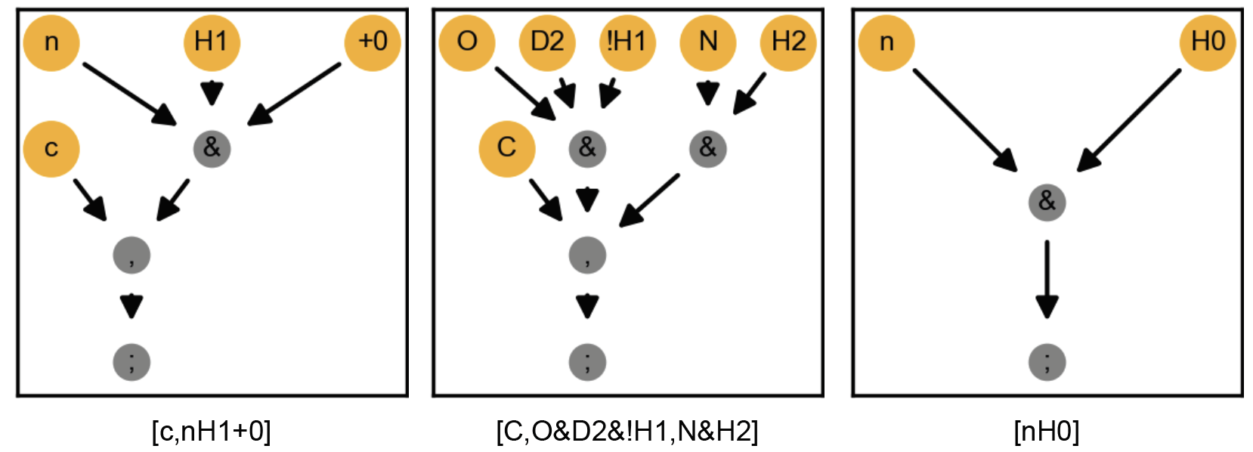
RDCanon
How to canonicalize SMARTS:
Parsing
Sorting
Decoding
Regeneration of stereochemistry
A grammar was developed to encode SMARTS strings into a tractable data format
Hash table enables initial consolation of subqueries and removal of redundancies (e.g., [O+++] becomes [O&+3], [C;H1;H1] becomes just [C;H1], etc.)
Hash table is converted into a query tree representing the expression’s hierarchical structure
query trees
Basically, an abstract syntax tree

Slide 10
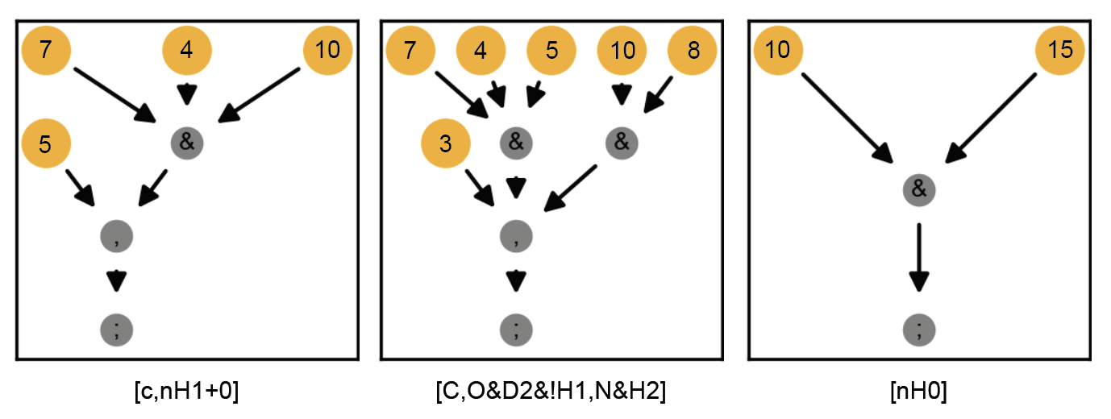
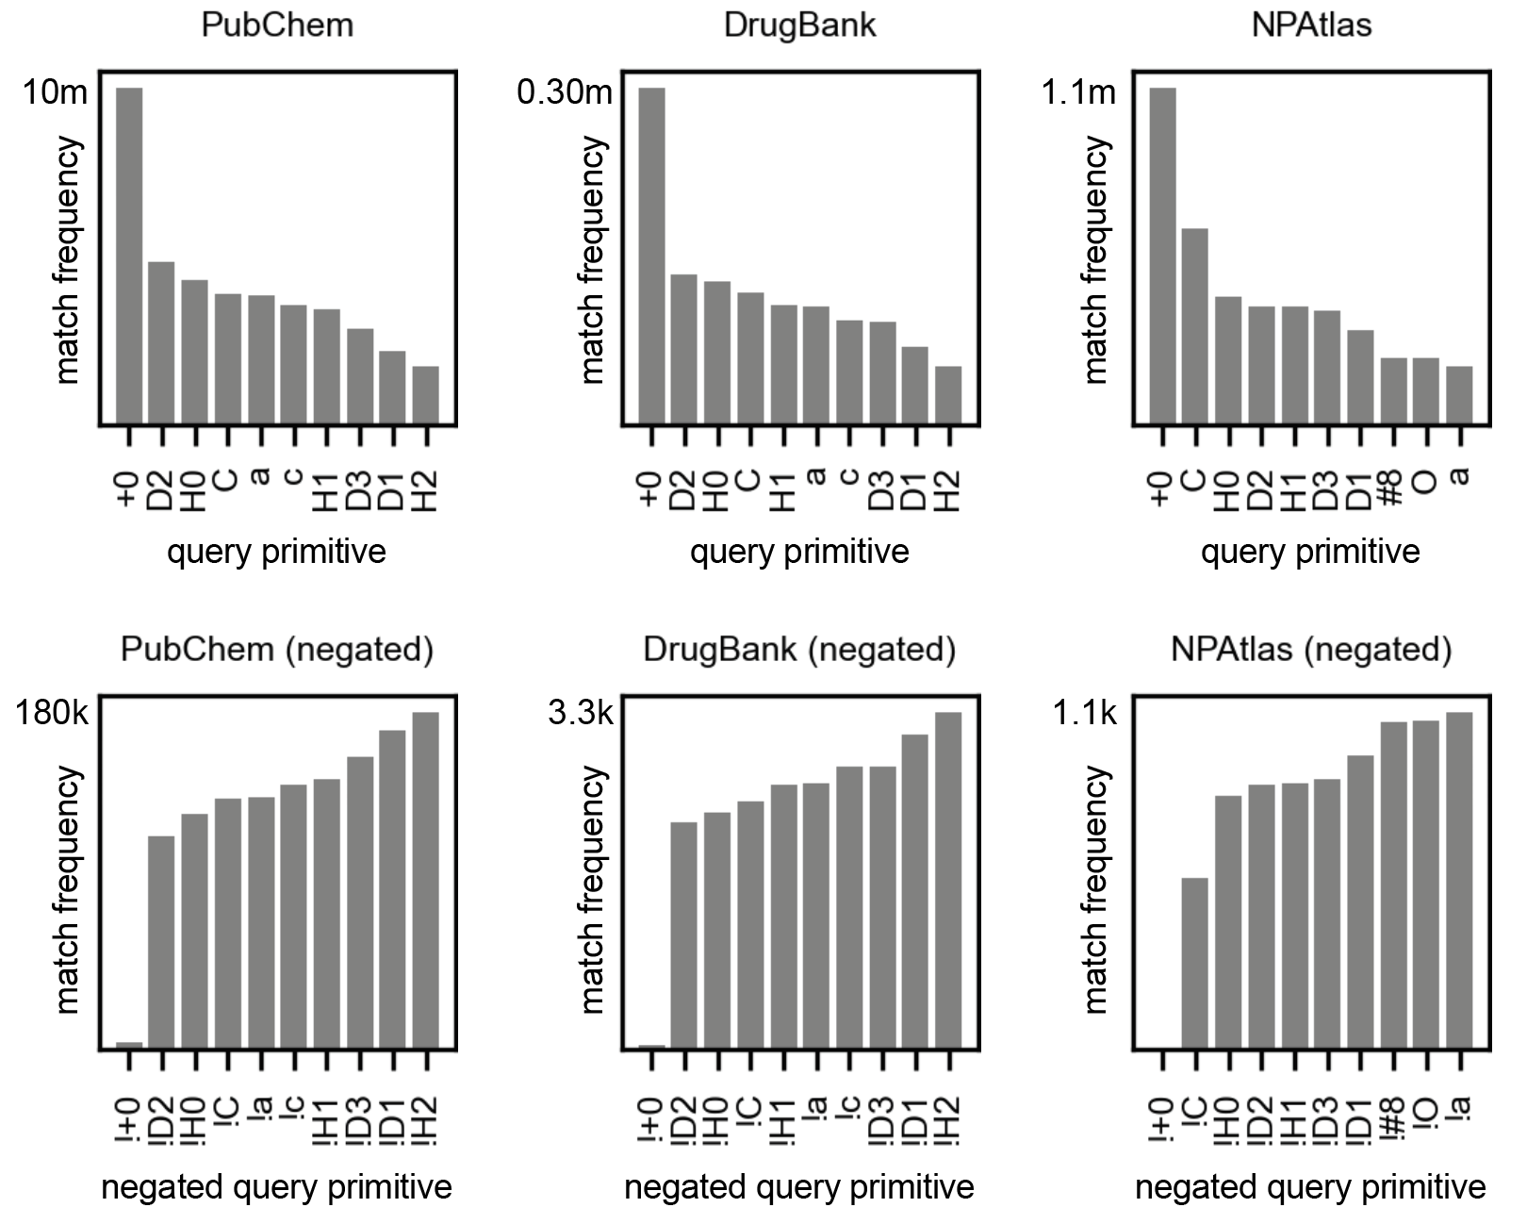
RDCanon
query trees
How to canonicalize SMARTS:
Parsing
Sorting
Decoding
Regeneration of stereochemistry
primitives are embedded with a frequency score derived from a molecular database or user-supplied dictionary

Slide 11
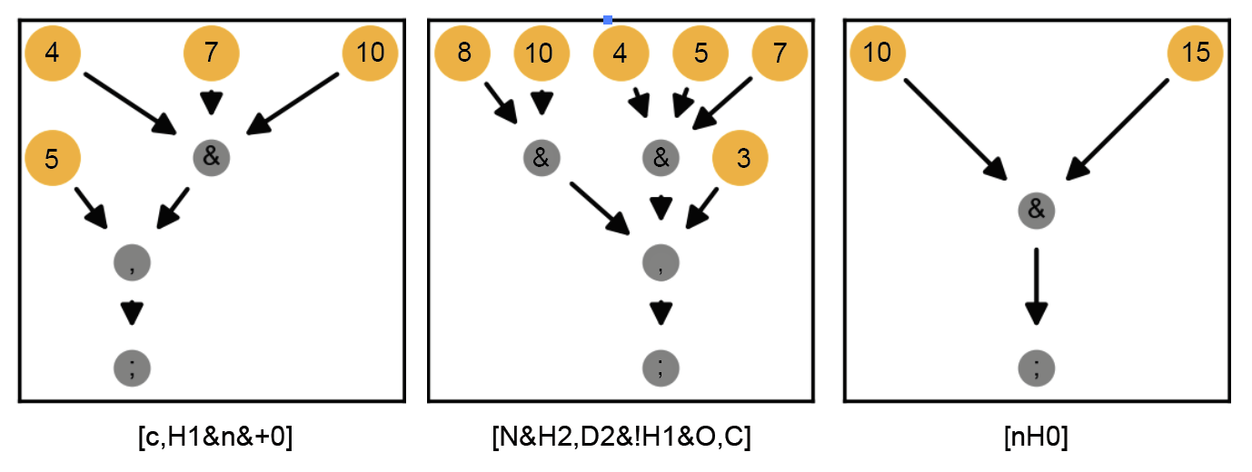
RDCanon
query trees
How to canonicalize SMARTS:
Parsing
Sorting
Decoding
Regeneration of stereochemistry
primitives are embedded with a frequency score derived from a molecular database or user-supplied dictionary
sort from low-to-high at ‘and’ nodes
sort from high-to-low at ‘or’ nodes

Slide 12
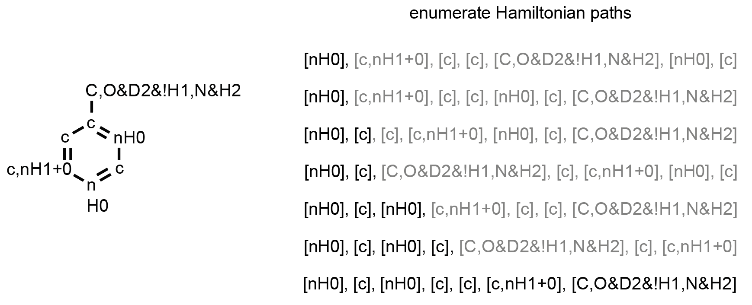
RDCanon
How to canonicalize SMARTS:
Parsing
Sorting
Decoding
Regeneration of stereochemistry
best sequence generated by starting at rarest atomic query
prune non-optimal paths until only one remains
SMARTS are regenerated with branching and ring information using path enumeration with backtracking

Slide 13
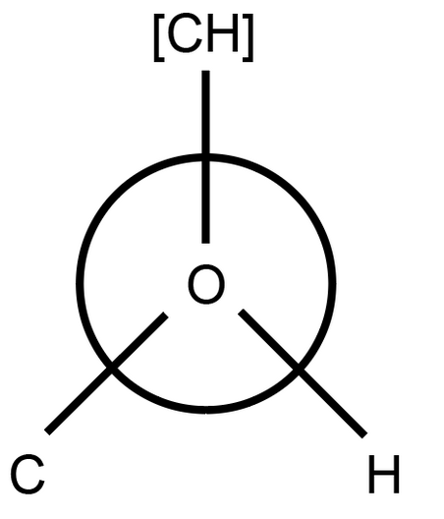
RDCanon
How to canonicalize SMARTS:
Parsing
Sorting
Decoding
Regeneration of stereochemistry
Chiral tags specify 3D configuration of tetrahedral centers
@ = following three tokens are CCW around center, @@ = CW
Thus, permutation invariance must be checked when tokens are reordered, flipping the chiral tag when necessary
[O][C@][CH][C]
[O][C@@][C][CH]

Slide 14
RDCanon
How to canonicalize SMARTS:
Parsing
Sorting
Decoding
Regeneration of stereochemistry
Chiral tags specify 3D configuration of tetrahedral centers
@ = following three tokens are CCW around center, @@ = CW
Thus, permutation invariance must be checked when tokens are reordered, flipping the chiral tag when necessary
Similarly, local E/Z configuration must be checked and maintained, flipping directional single bonds when necessary
O\C=C(\C)N
N\C(C)=C/O

Slide 15
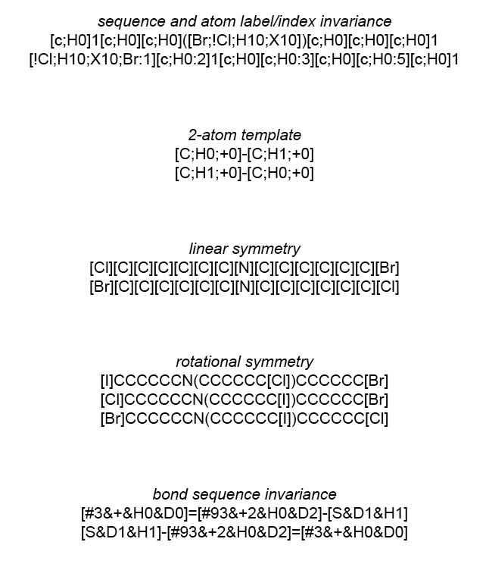
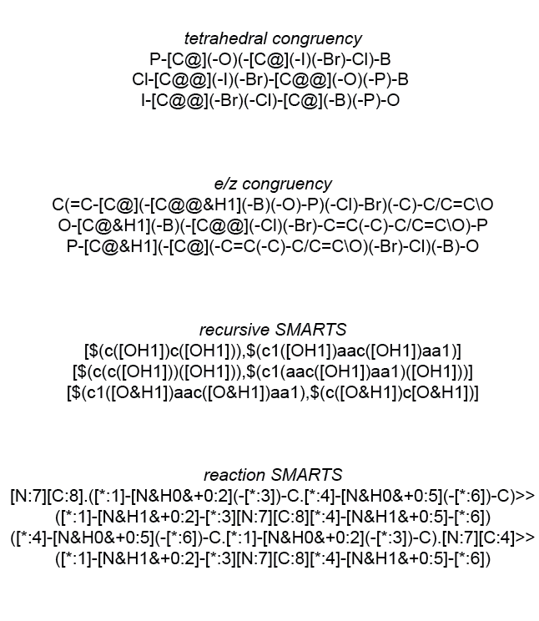
RDCanon

Slide 16
RDCanon

Slide 17
RDCanon

Slide 18
RDCanon

Slide 19
RDCanon

Slide 20
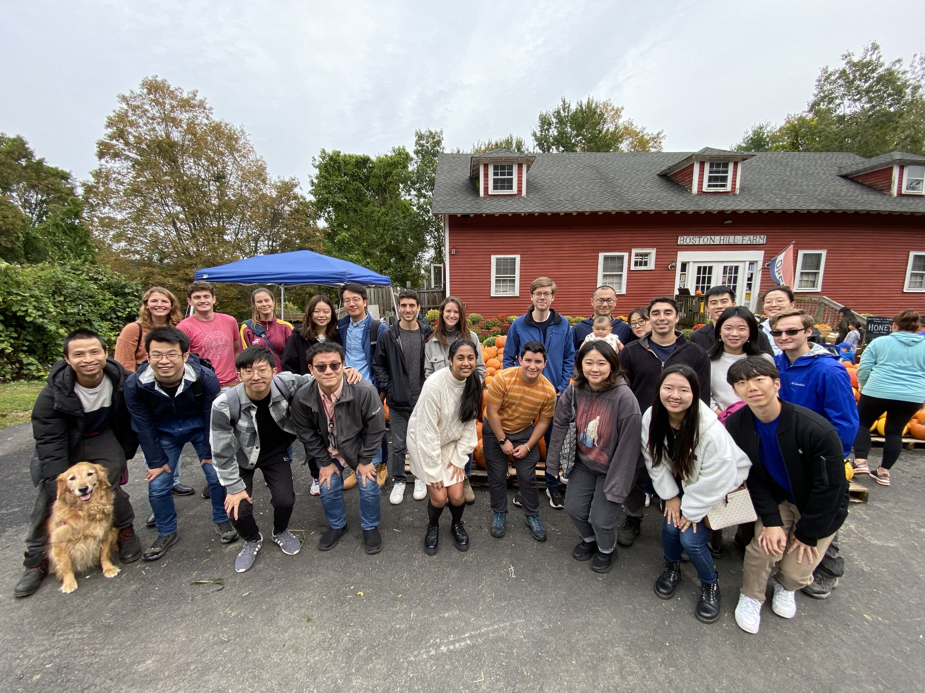
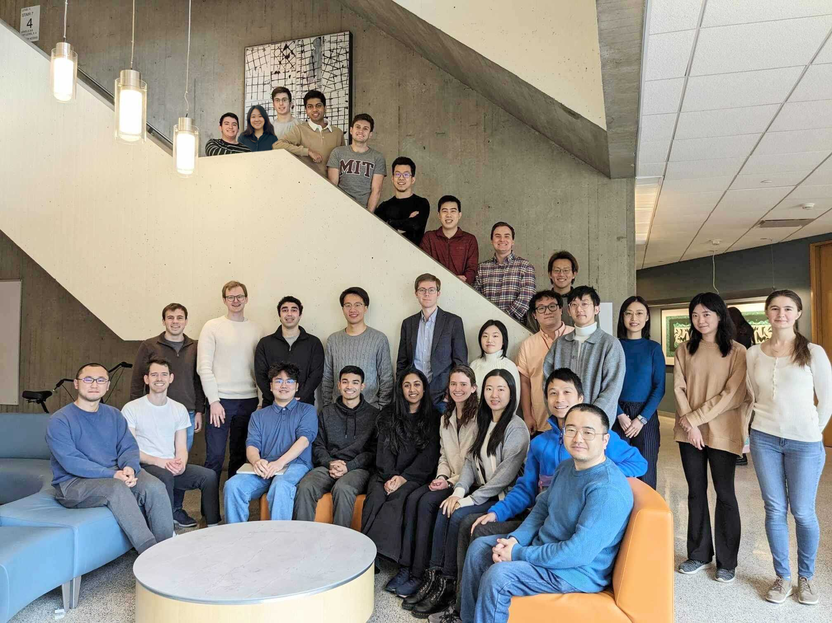
Thank You :)
Thank you to:
My teammates in the Coley Research Group
MIT and the Dept. of Chemical Engineering
Novo Nordisk for fellowship funding

Slide 21

Jeff Wagner to present “virtually”

